Slide 1

Cloud Application Architecture Styles
Session 01

Slide 2
AGENDA
Architecture styles
N-tier
Web-Queue-Worker
Microservices
CQRS
Event-driven
Data architecture
Compute architecture
Architecture styles as constraints

Slide 3
Objectives
This session presents a structured approach for designing and architecting applications on Azure that are scalable, secure, resilient, and highly available.
It is based on proven practices that we have learned from customer engagements.

Slide 4
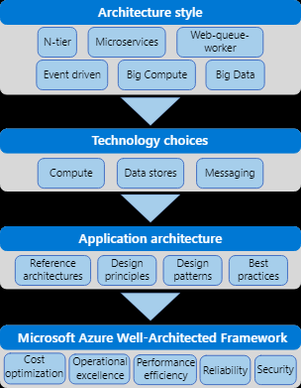
How this session is structured
Etc.
Notes:
The Azure Application Architecture Guide is organized as a series of steps, from the architecture and design to implementation. For each step, there is supporting guidance that will help you with the design of your application architecture.

Slide 5
Architecture Styles
An architecture style is a family of architectures that share certain characteristics.
Architecture styles don't require the use of particular technologies, but some technologies are well-suited for certain architectures.

Slide 6
N-tier
N-tier is a traditional architecture for enterprise applications.
Dependencies are managed by dividing the application into layers that perform logical functions, such as presentation, business logic, and data access.
N-tier is a natural fit for migrating existing applications that already use a layered architecture. For that reason, N-tier is most often seen in infrastructure as a service (IaaS) solutions, or application that use a mix of IaaS and managed services.

Slide 7
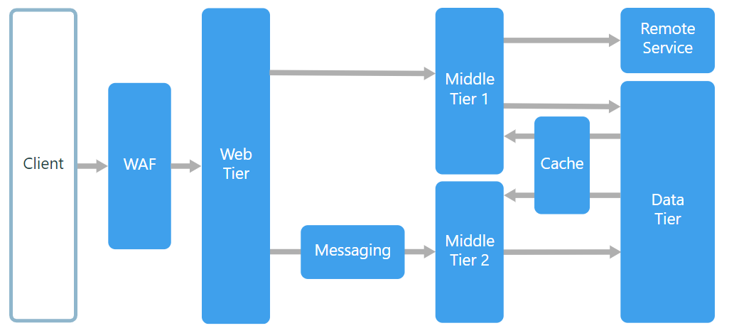
N-tier architecture divides an application into logical layers and physical tiers.

Slide 8
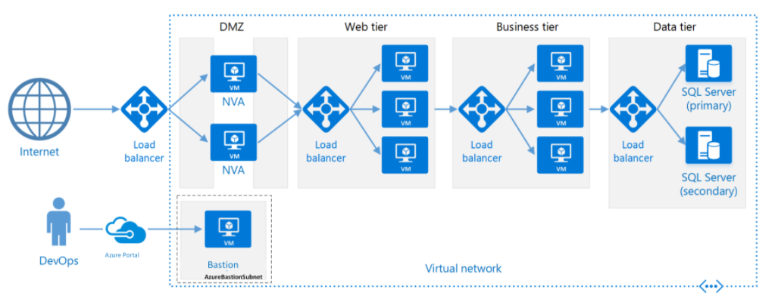
N-tier architecture running on VMs

Slide 9
Benefits
Portability between cloud and on-premises, and between cloud platforms.
Less learning curve for most developers.
Natural evolution from the traditional application model.
Open to heterogeneous environment (Windows/Linux)

Slide 10
Challenges
It's easy to end up with a middle tier that just does CRUD operations on the database, adding extra latency without doing any useful work.
Monolithic design prevents independent deployment of features.
Managing an IaaS application is more work than an application that uses only managed services.
It can be difficult to manage network security in a large system.

Slide 11
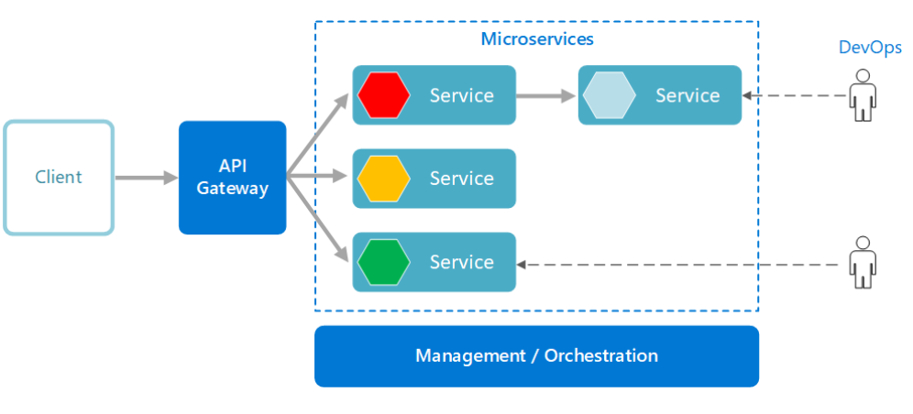
Microservices
A microservices architecture consists of a collection of small, autonomous services. Each service is self-contained and should implement a single business capability.

